Slide 1
PyTorch Tutorial
Xuming Wang Dec 8th

Slide 2
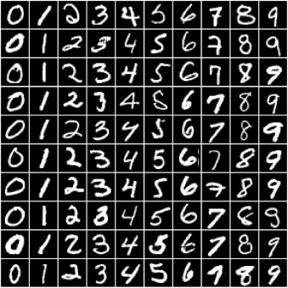
MNIST

Slide 3

Tensors

Slide 4
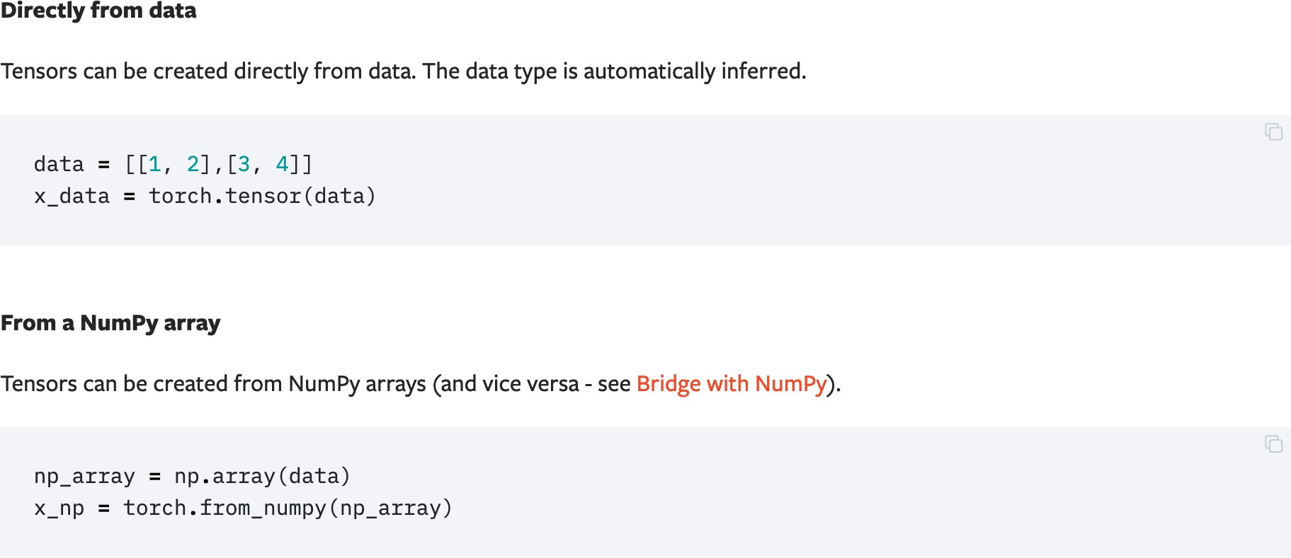
Initializing a Tensor
Notes:
this is similar to numpy

Slide 5
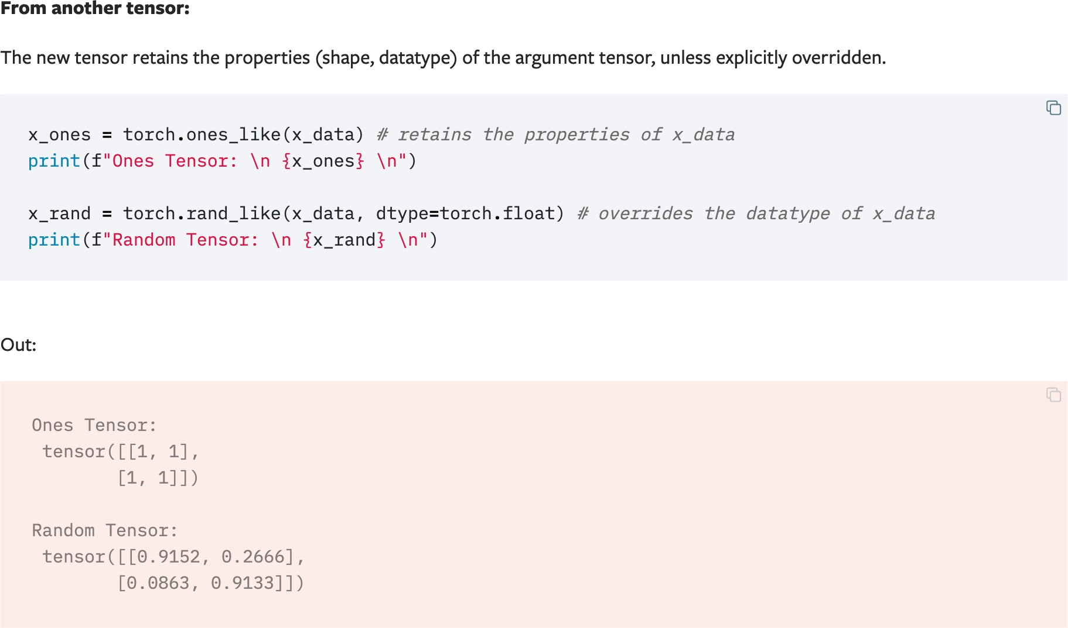
Initializing a Tensor

Slide 6
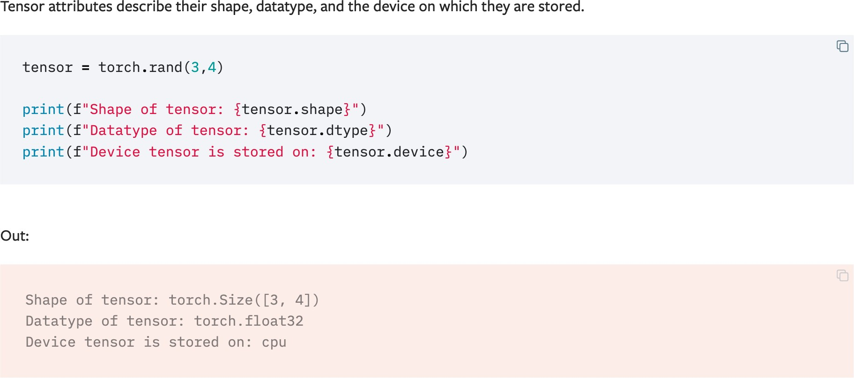
Attributes of a Tensor

Slide 7
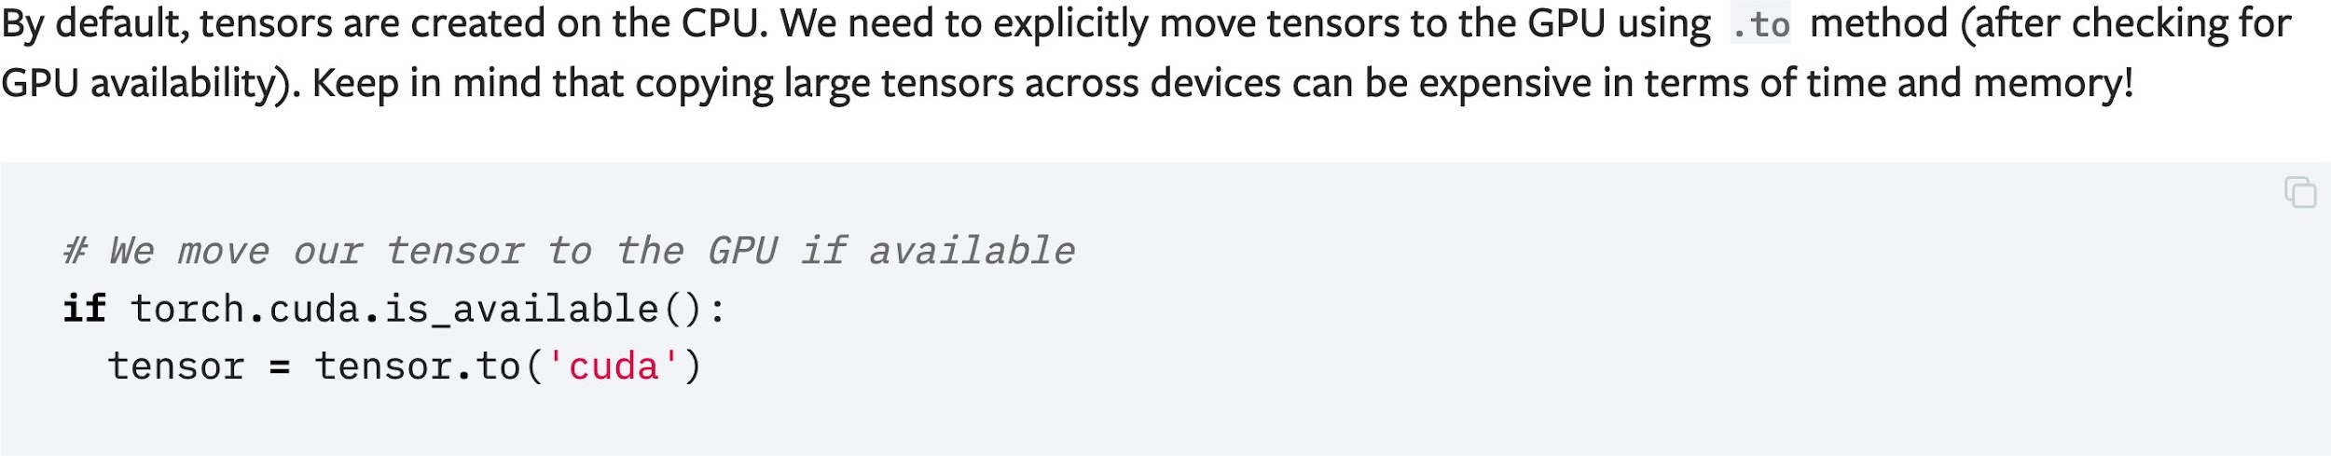
Operations on Tensors

Slide 8
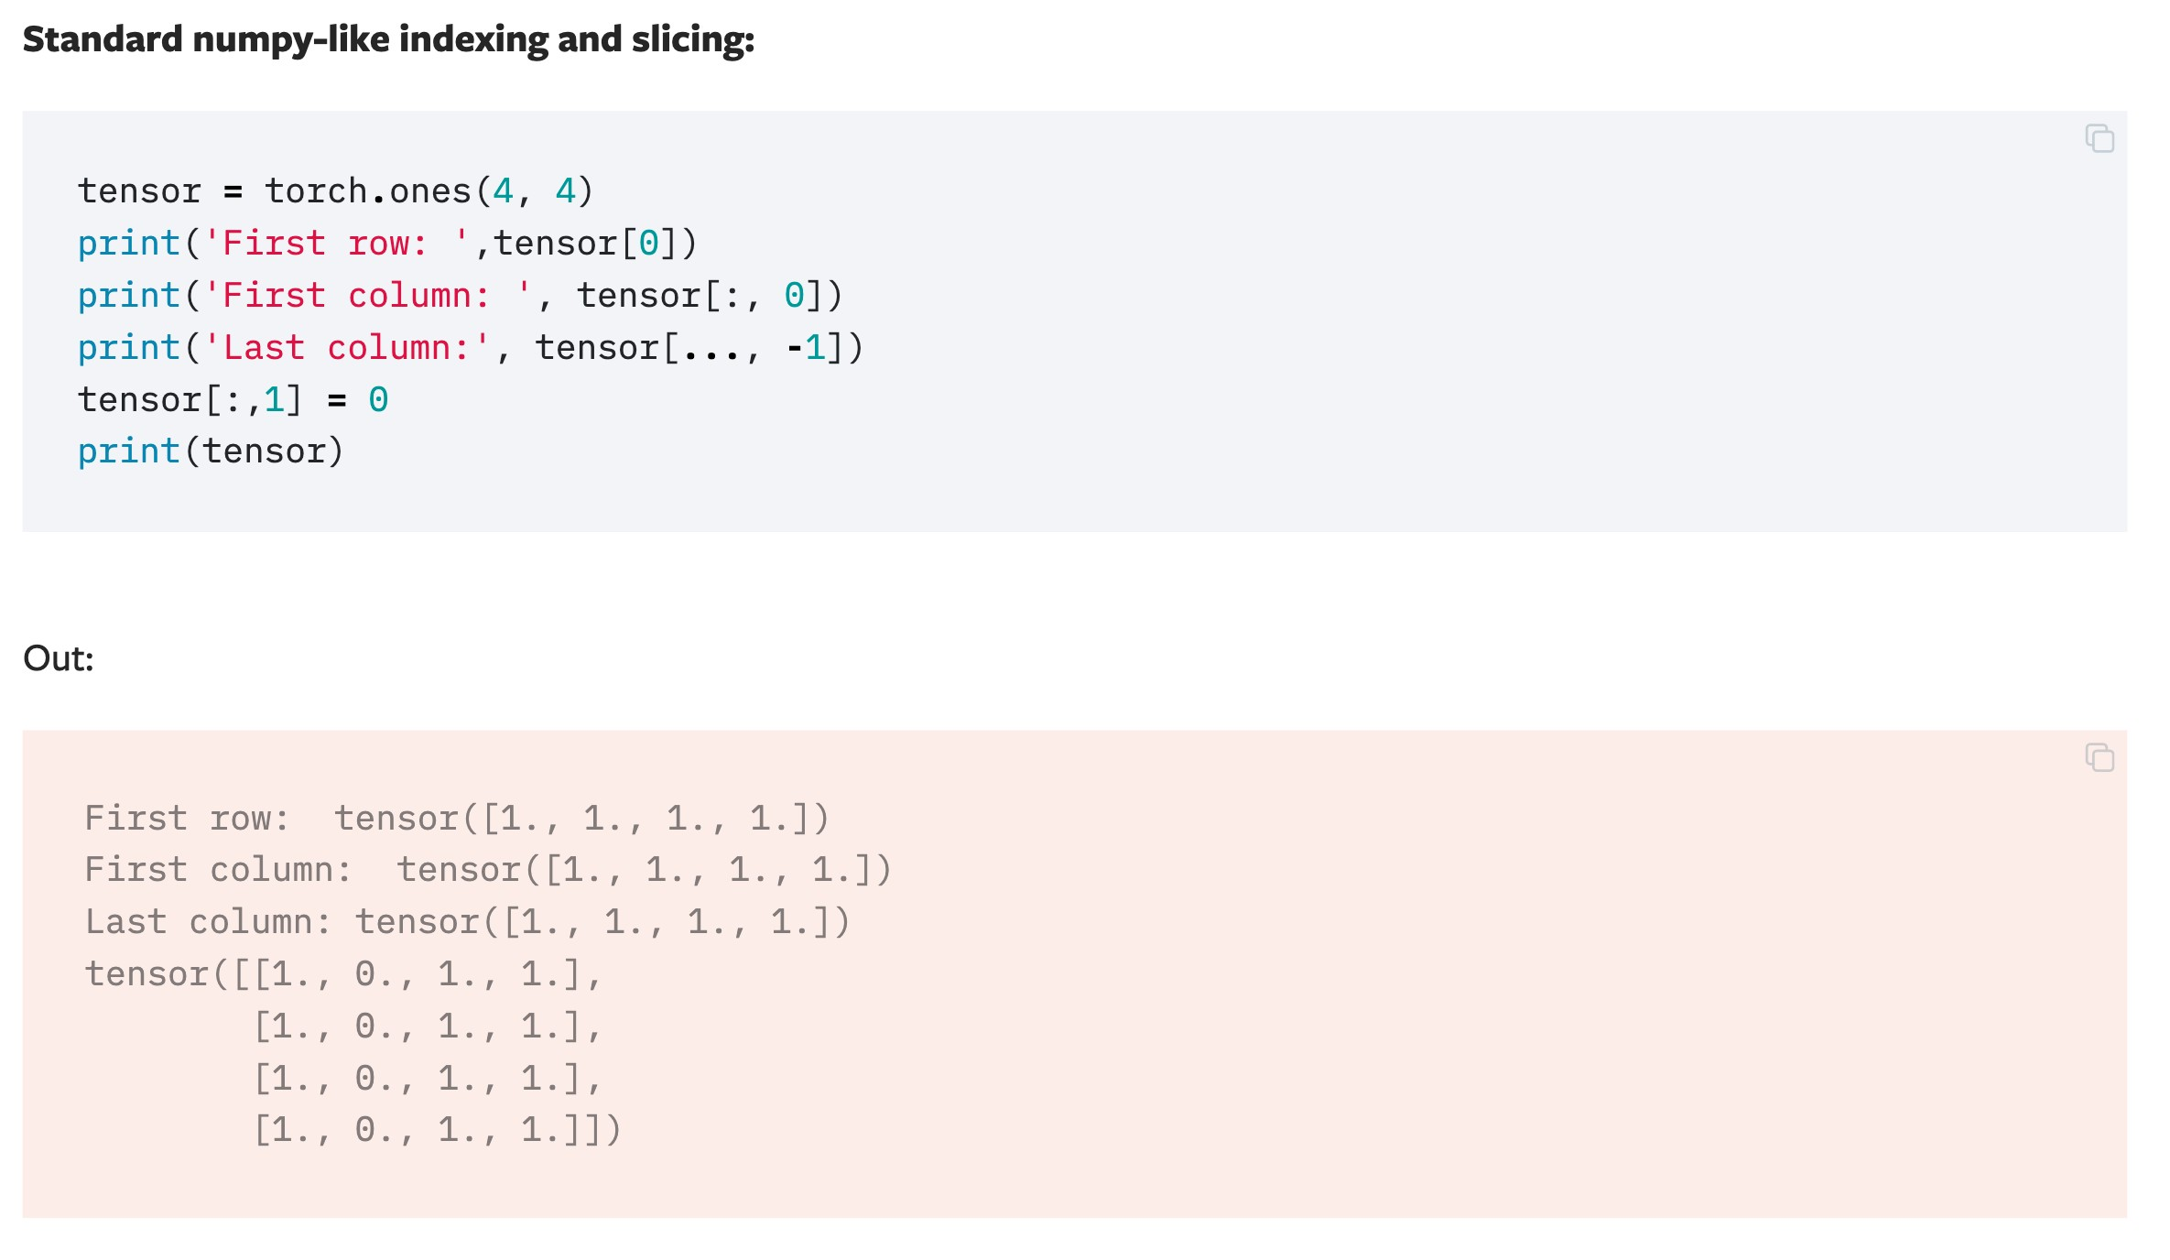
Operations on Tensors

Slide 9
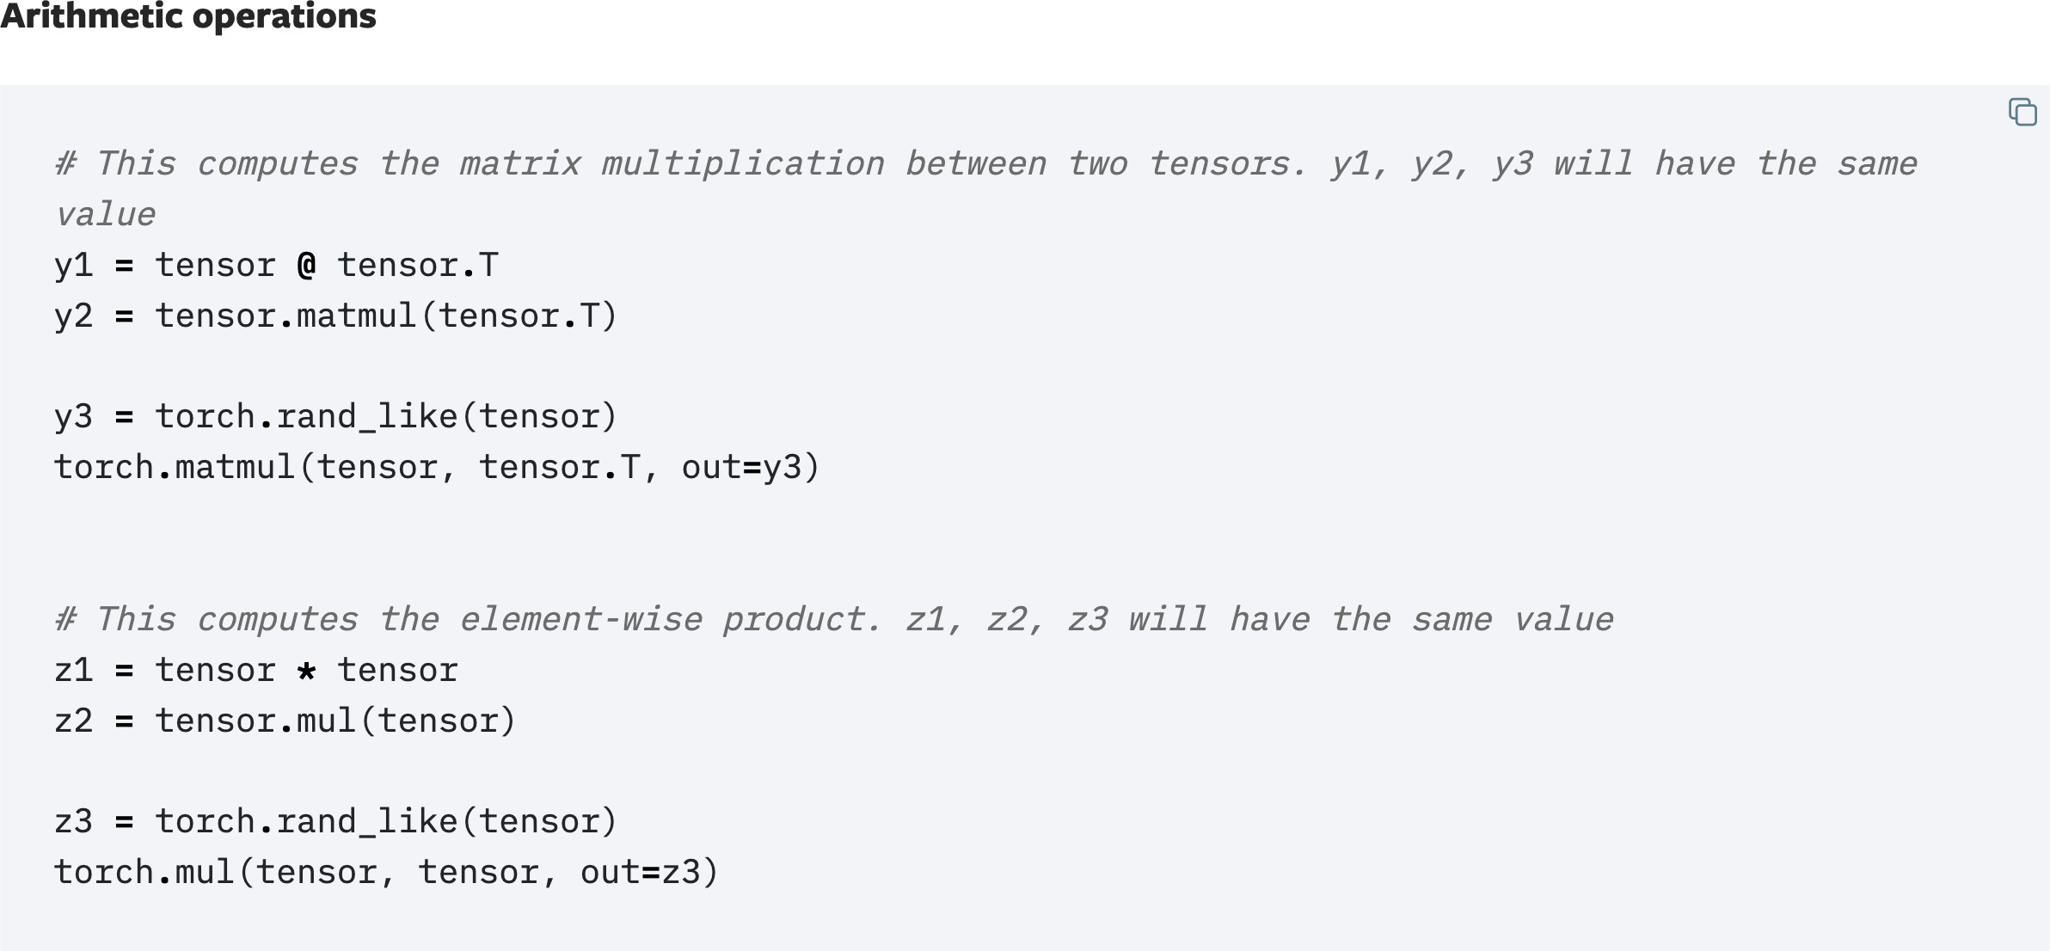
Operations on Tensors

Slide 10
Datasets & DataLoaders

Slide 11
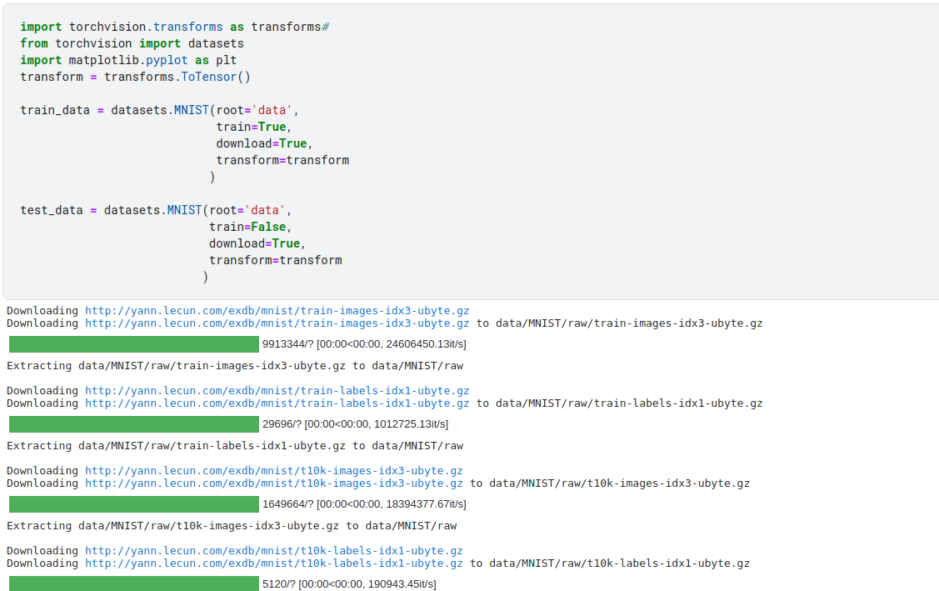
Loading a Dataset

Slide 12
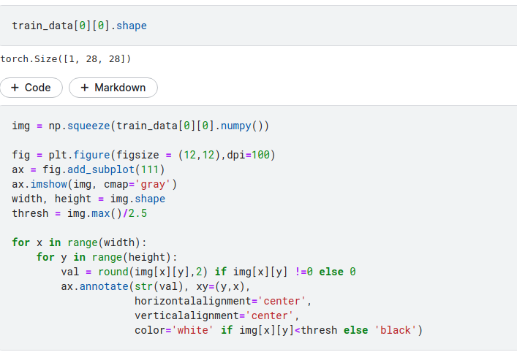
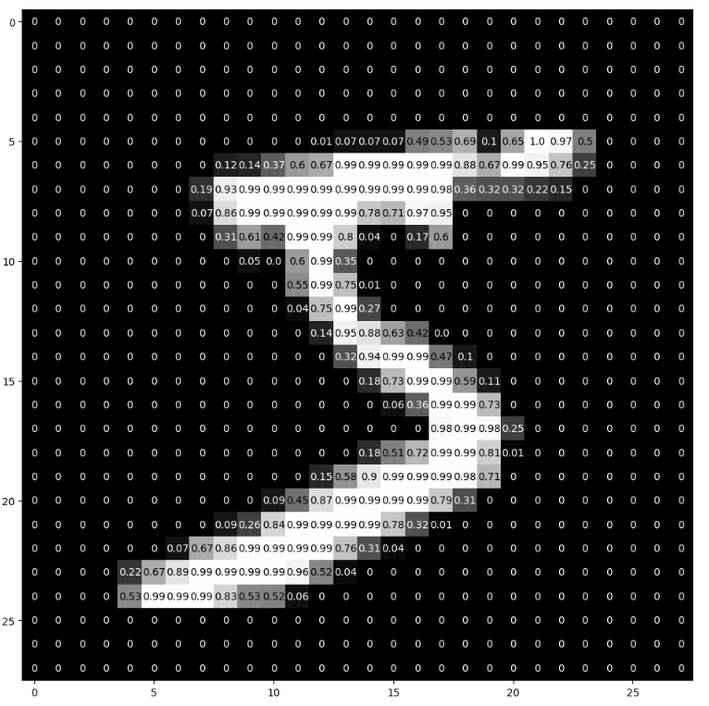
Iterating and Visualizing the Dataset

Slide 13
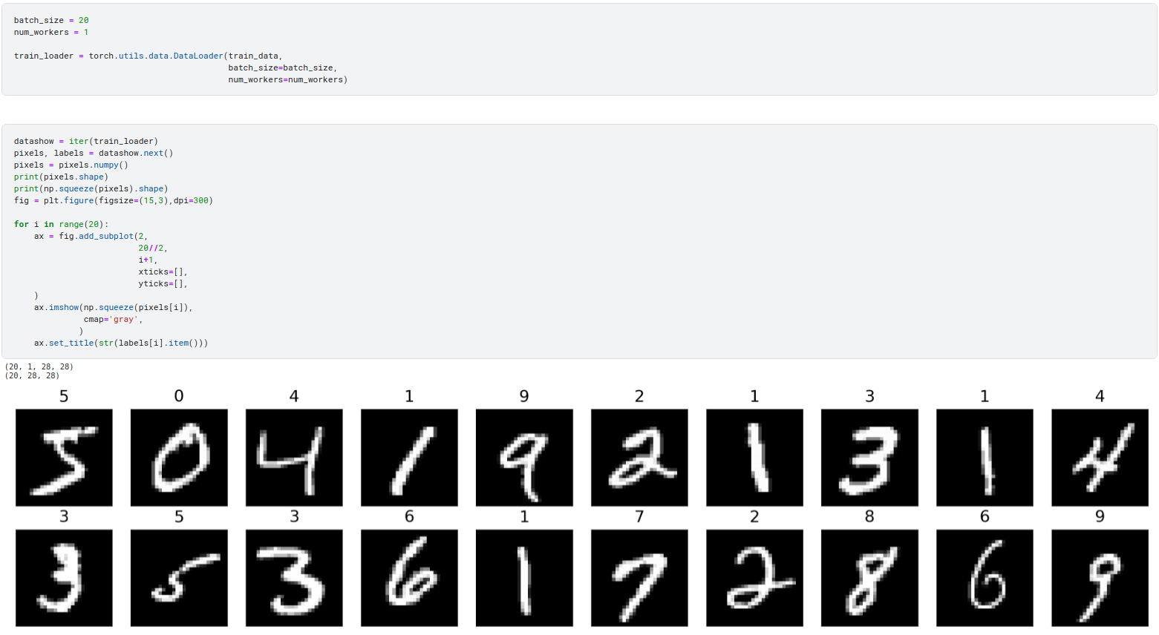
Iterating and Visualizing the Dataloader

Slide 14
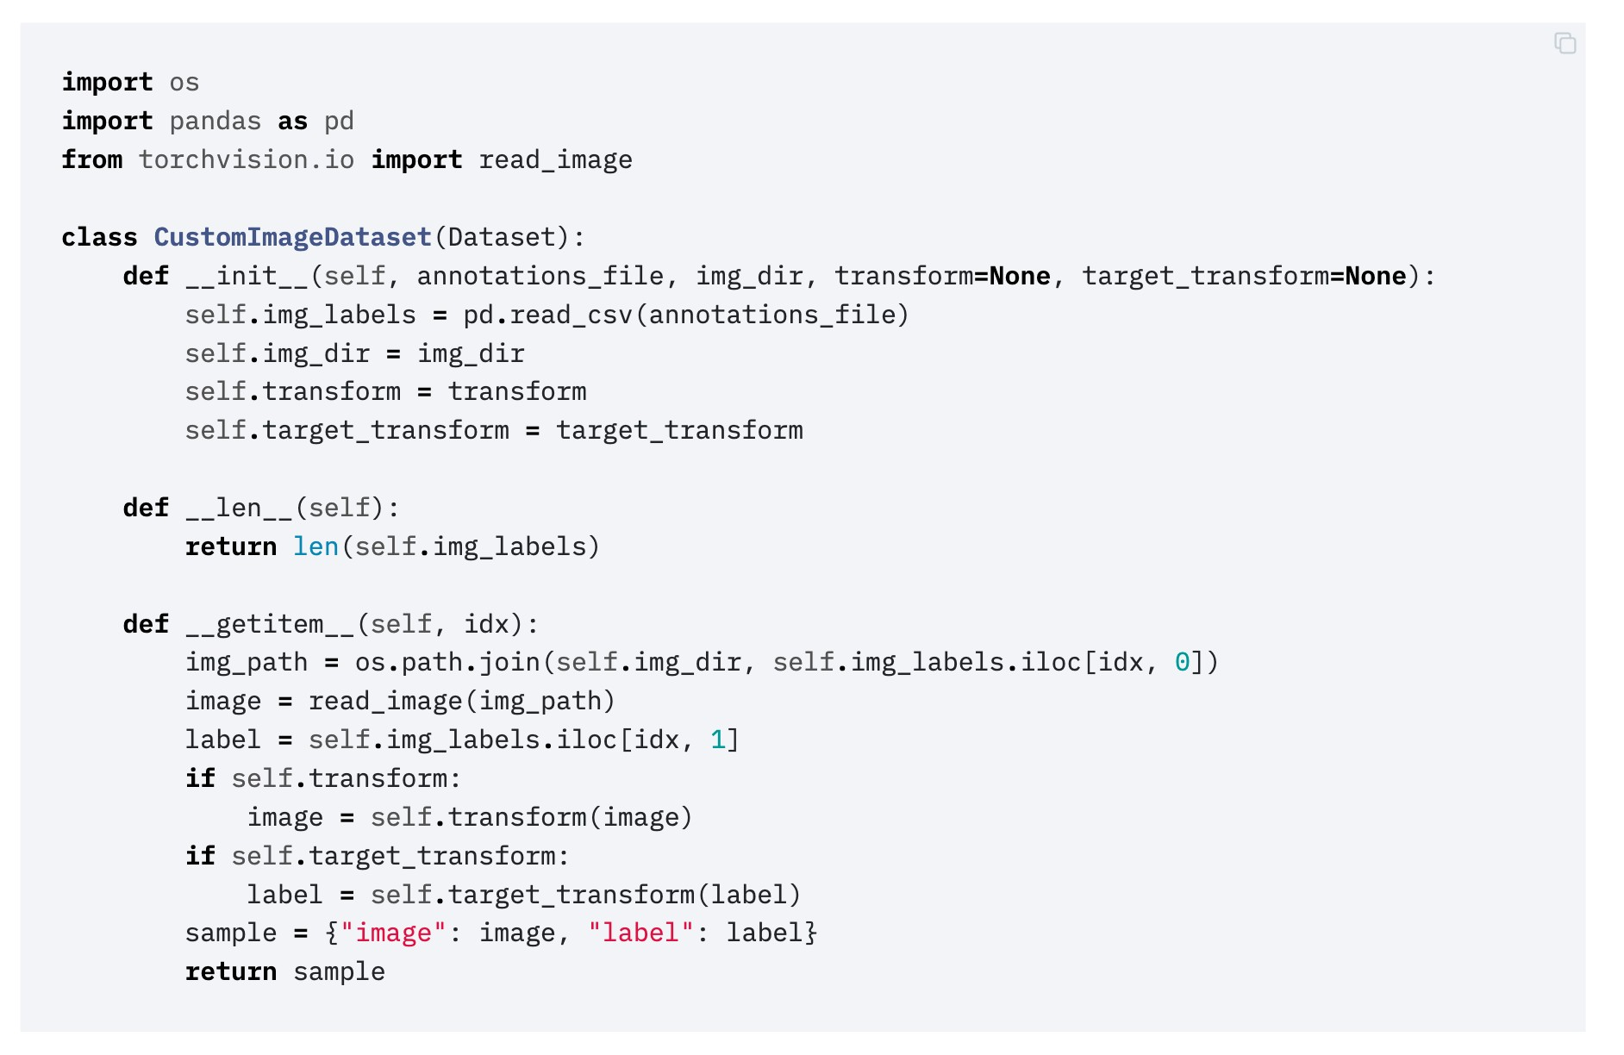
Creating a Custom Dataset for your files

Slide 15
Creating a Custom Dataset for your files

Slide 16
Creating a Custom Dataset for your files

Slide 17
Creating a Custom Dataset for your files

Slide 18
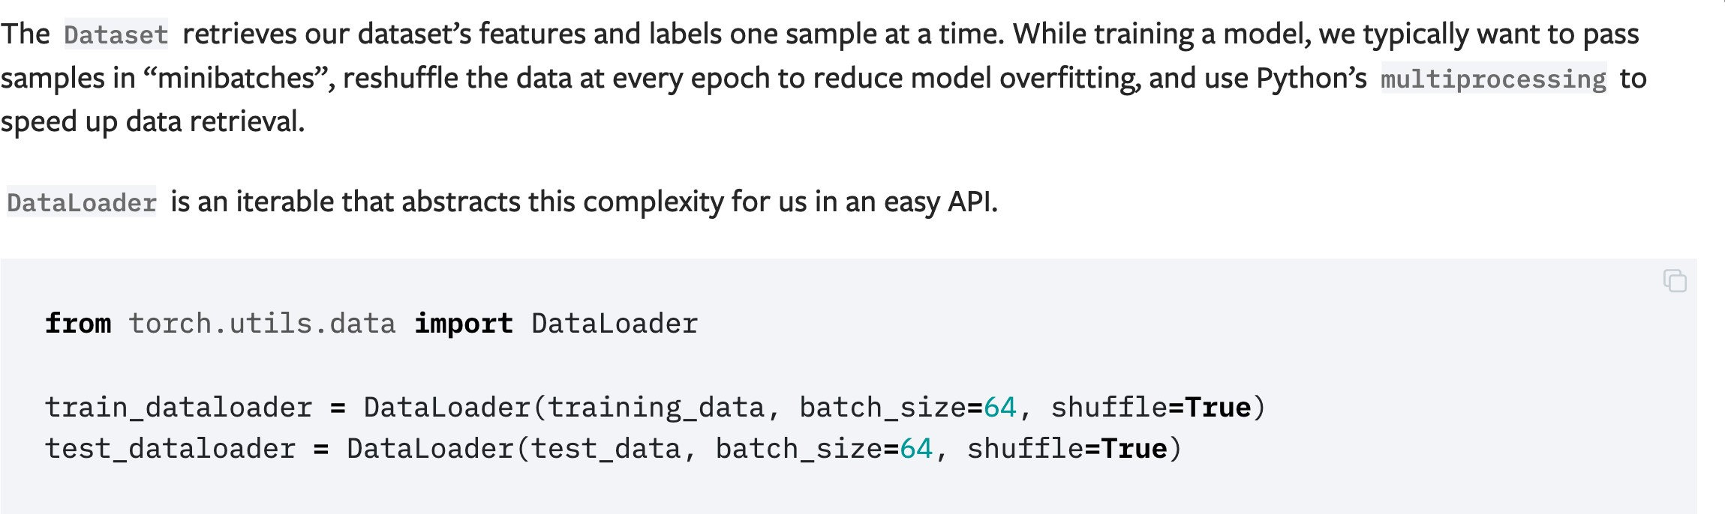
Preparing your data for training with DataLoaders

Slide 19
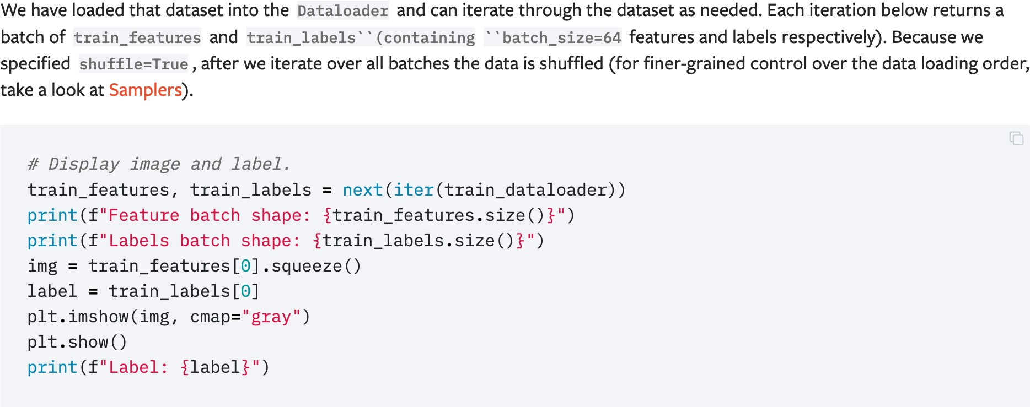
Iterate through the DataLoader

Slide 20
Neural Network

Slide 21
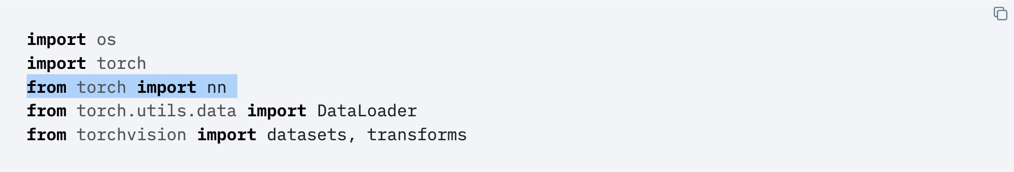
torch.nn.Module

Slide 22
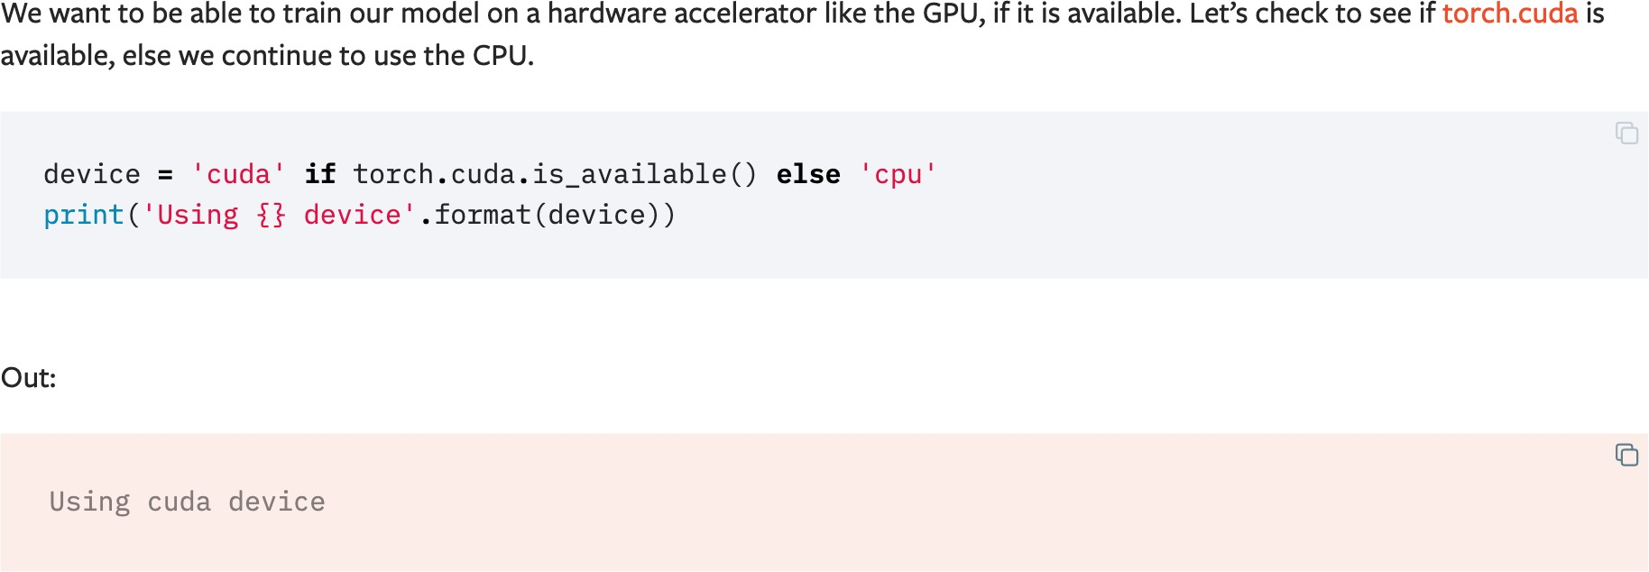
Get Device for Training

Slide 23
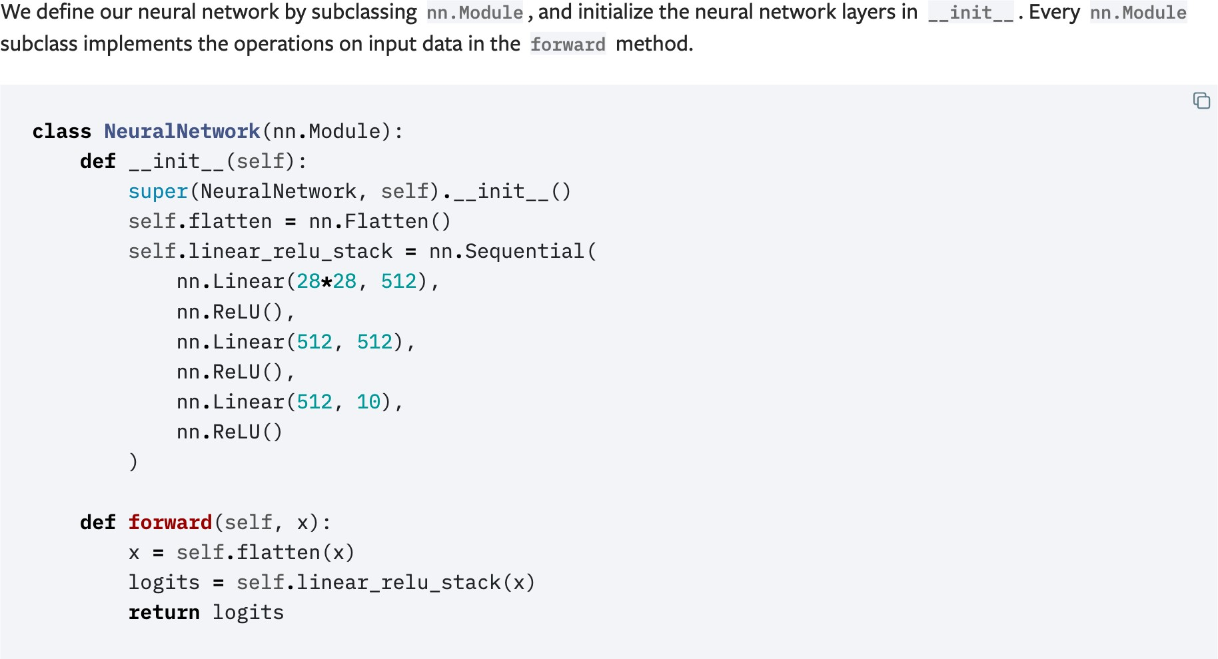
Define the Class
Notes:
Need change , remove Sequential()

Slide 24
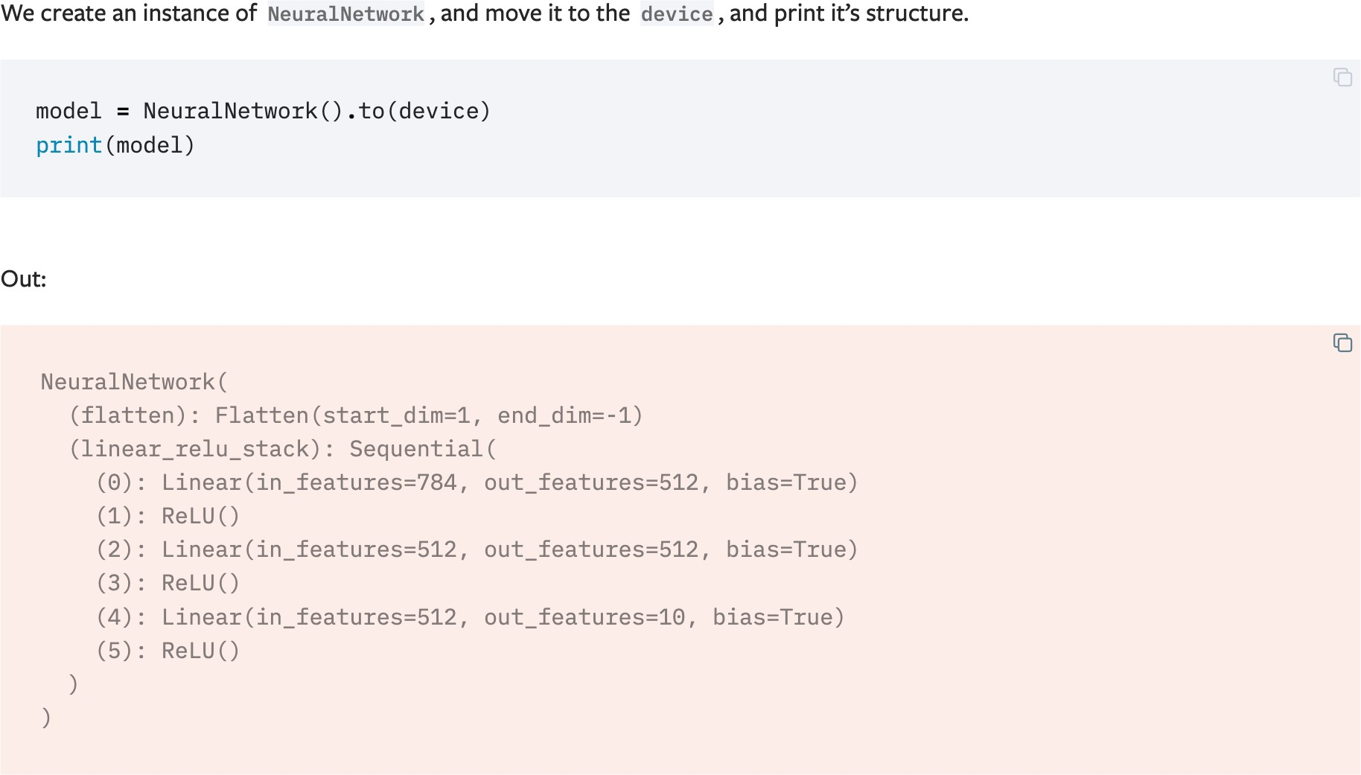
Define the Class

Slide 25
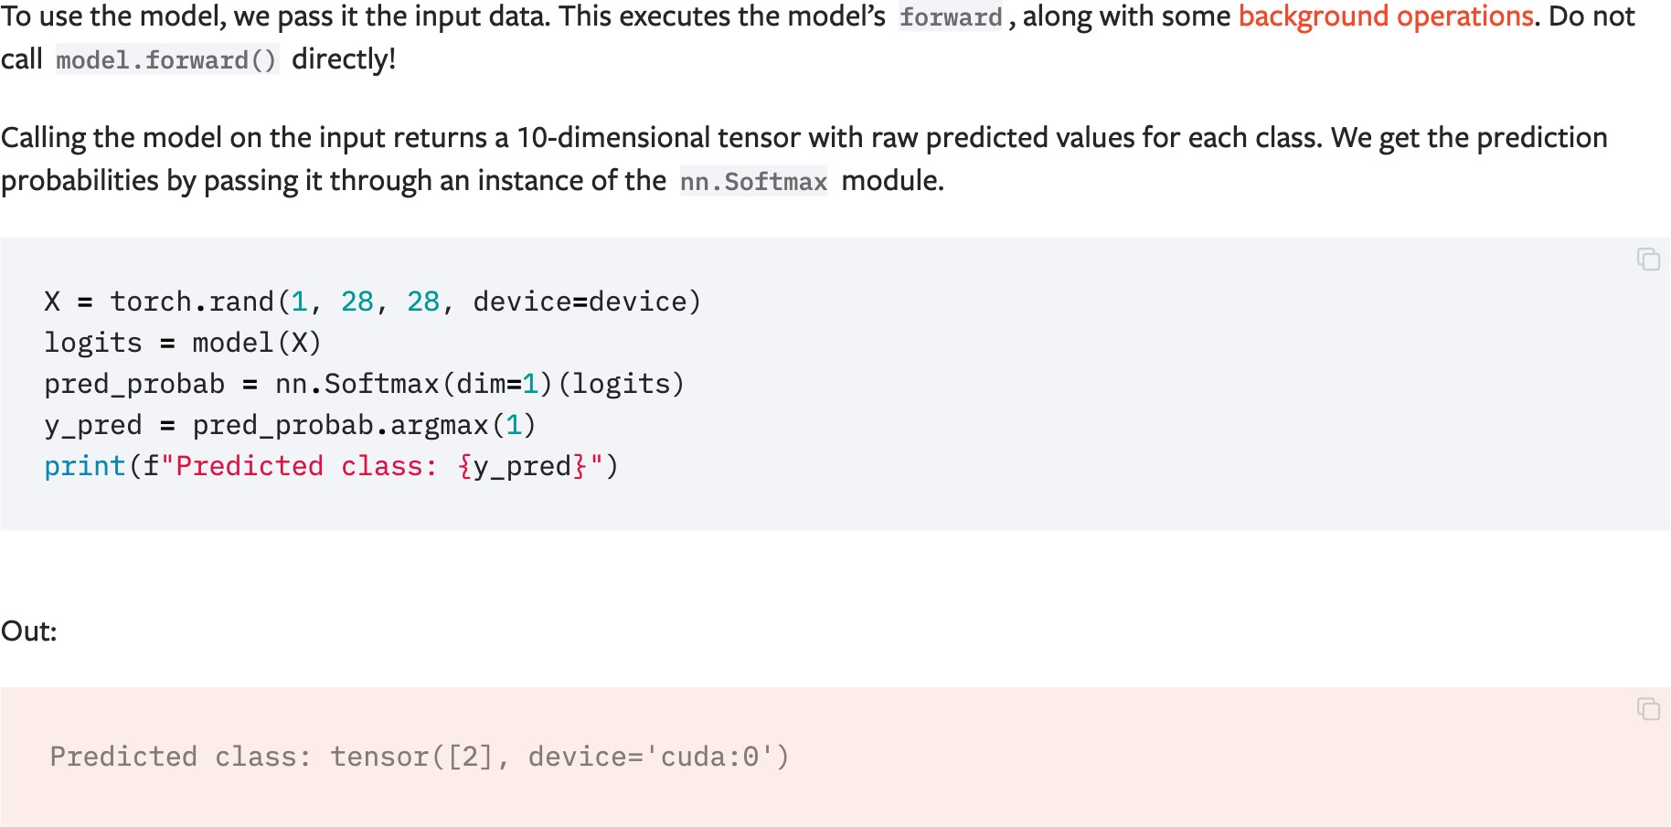
Define the Class

Slide 26
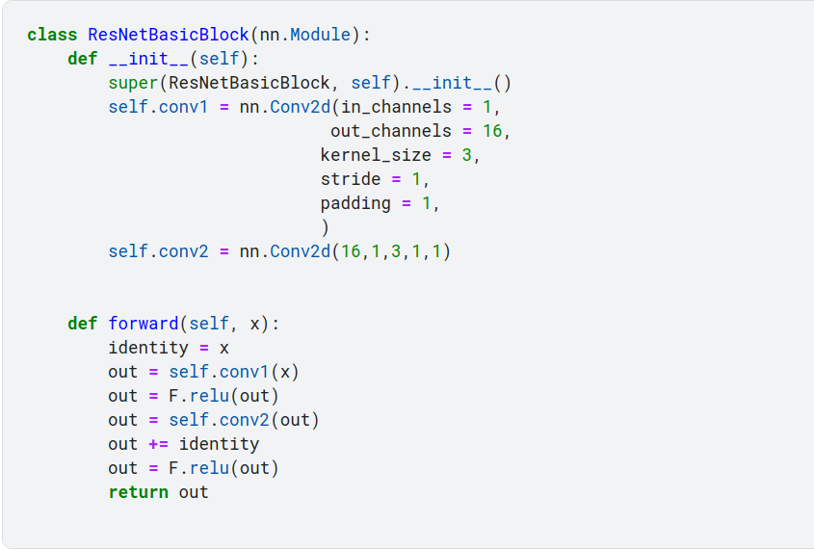
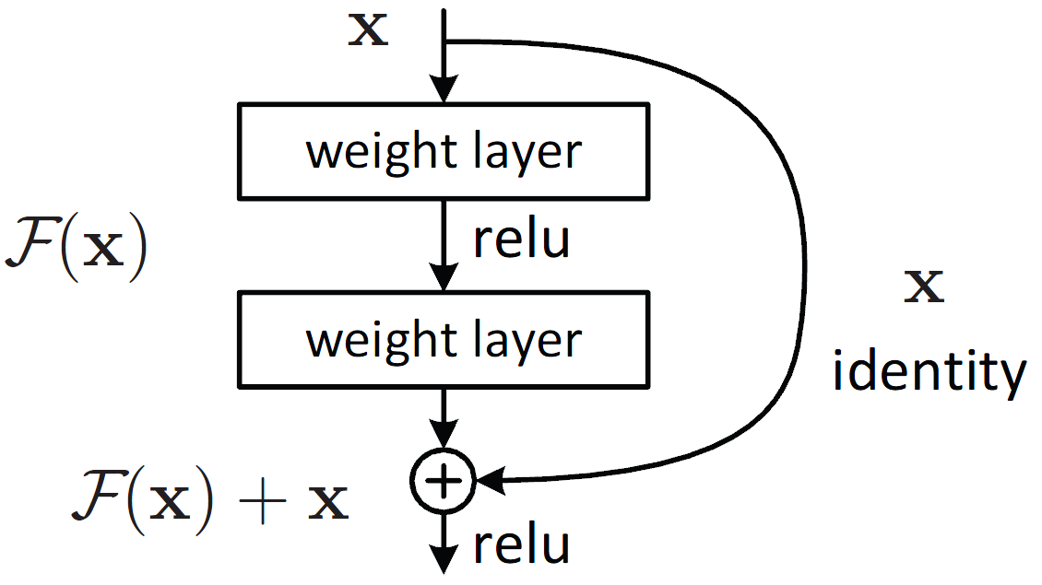
Define the Class(flexible)

Slide 27
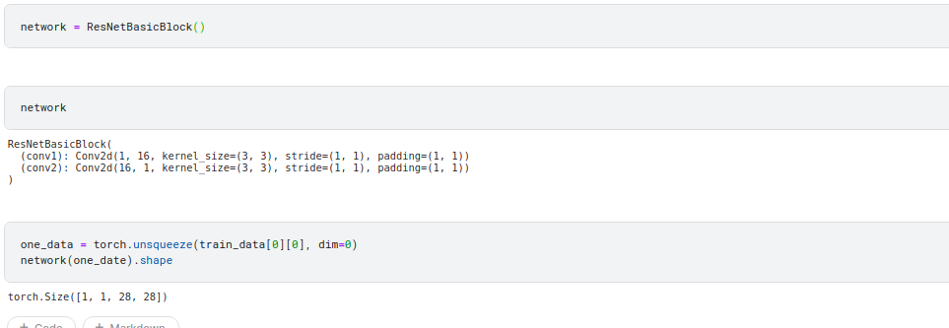
Define the Class(flexible)

Slide 28
Optimizing Model Params

Slide 29
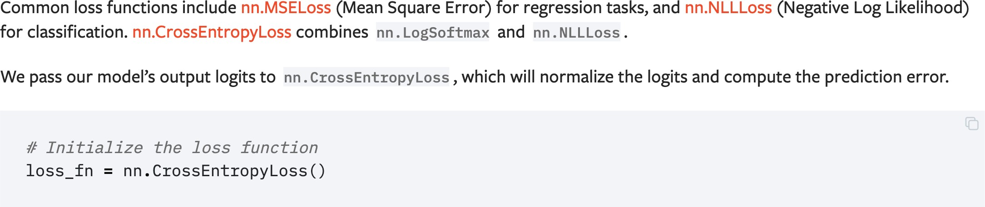
Loss Function
Notes:
Focal loss

Slide 30
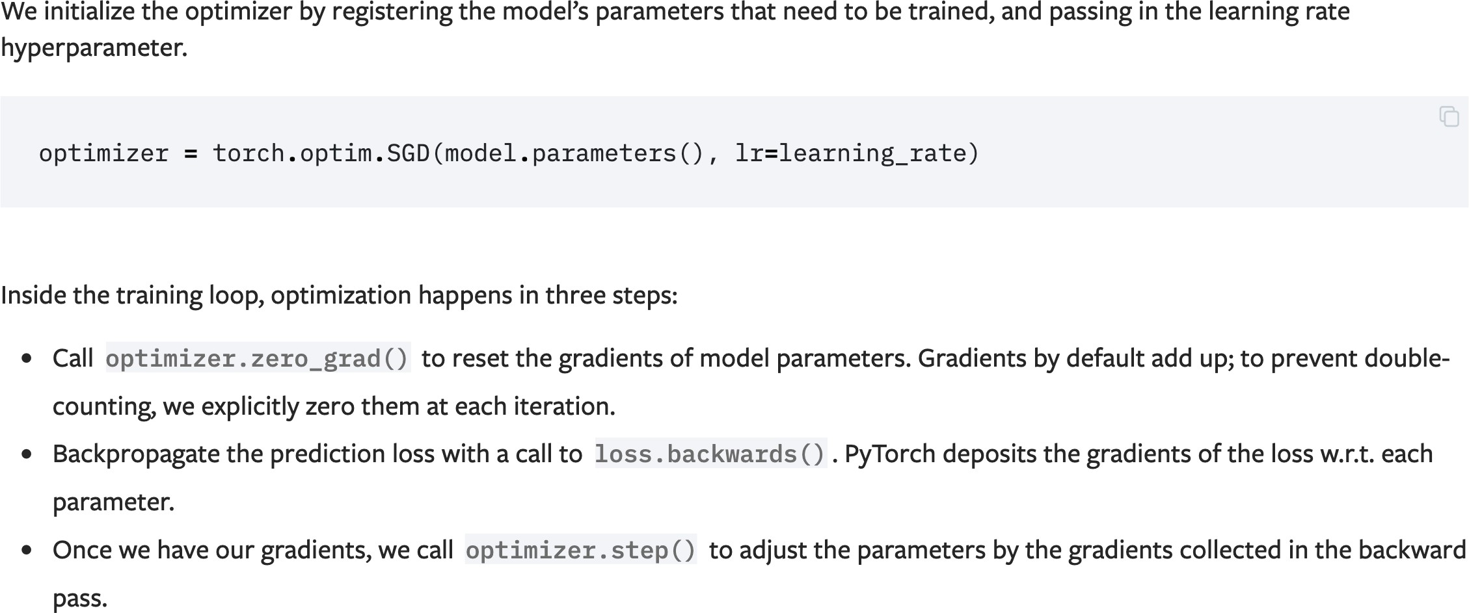
Optimizer

Slide 31
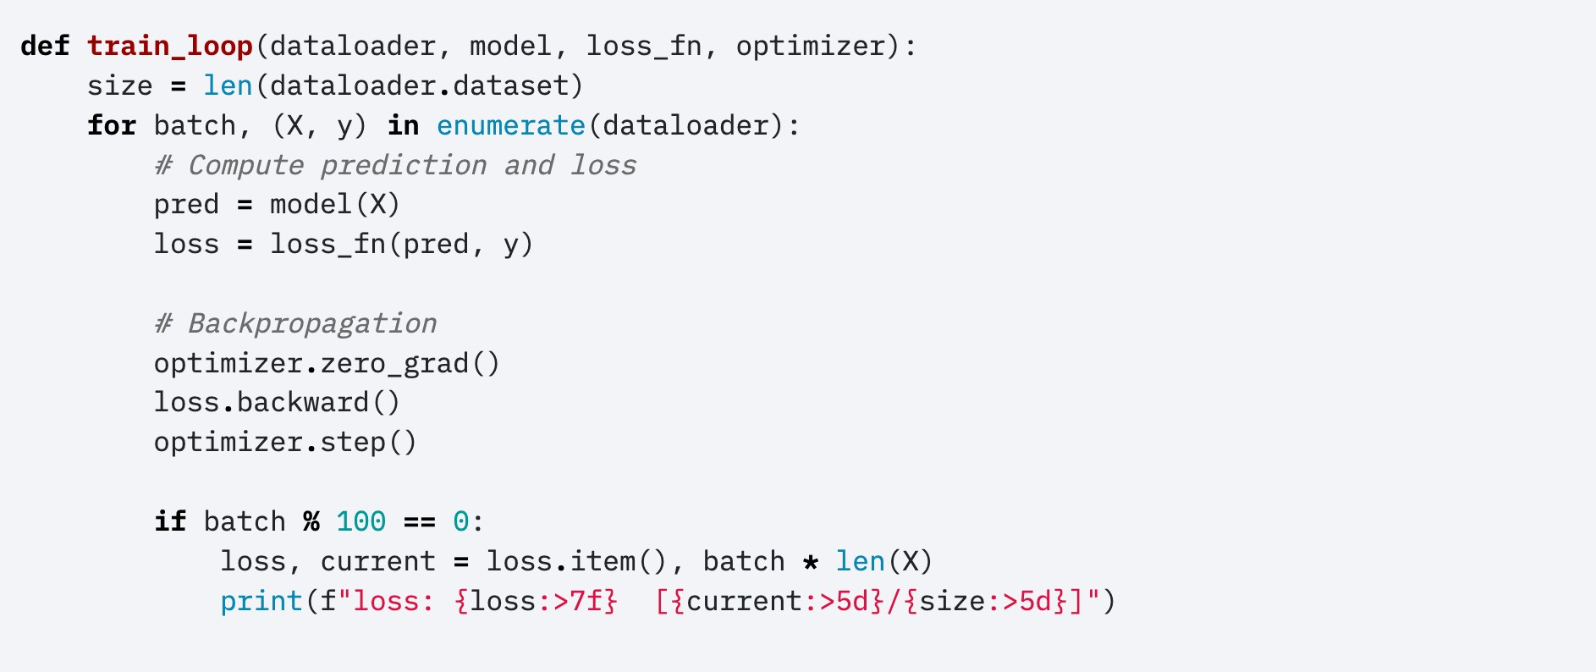
Full Implementation – Train Loop
Notes:
if batch % 4 == 0 :

Slide 32
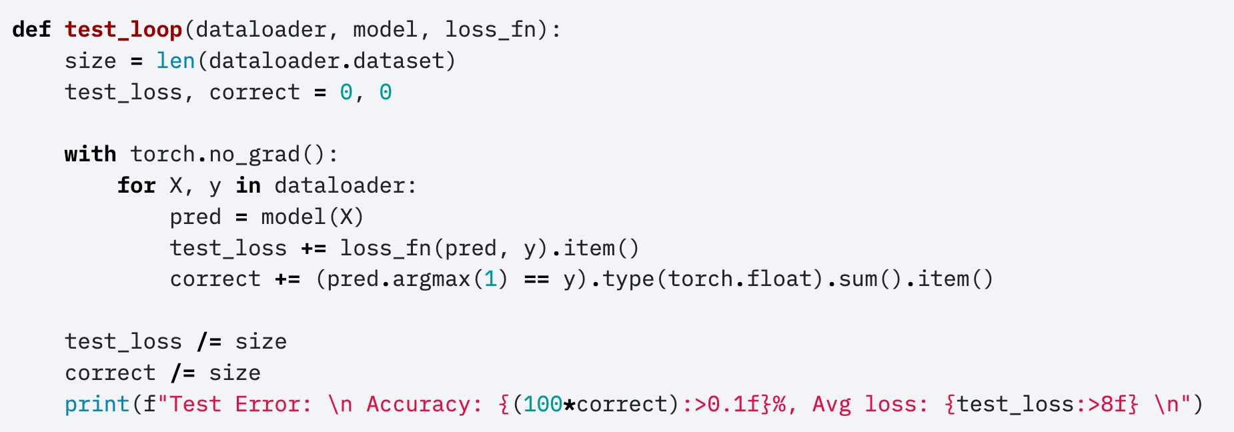
Full Implementation – Test Loop
Notes:
must have, no_grad

Slide 33
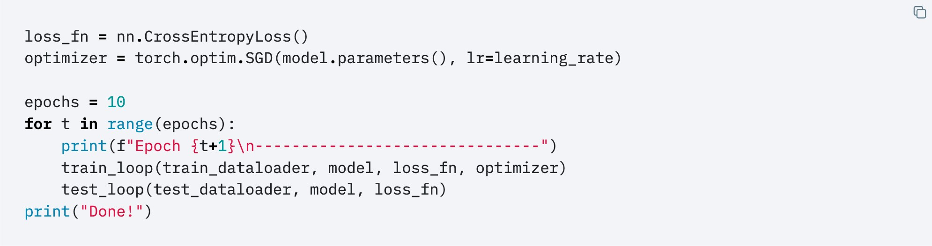
Full Implementation

Slide 34
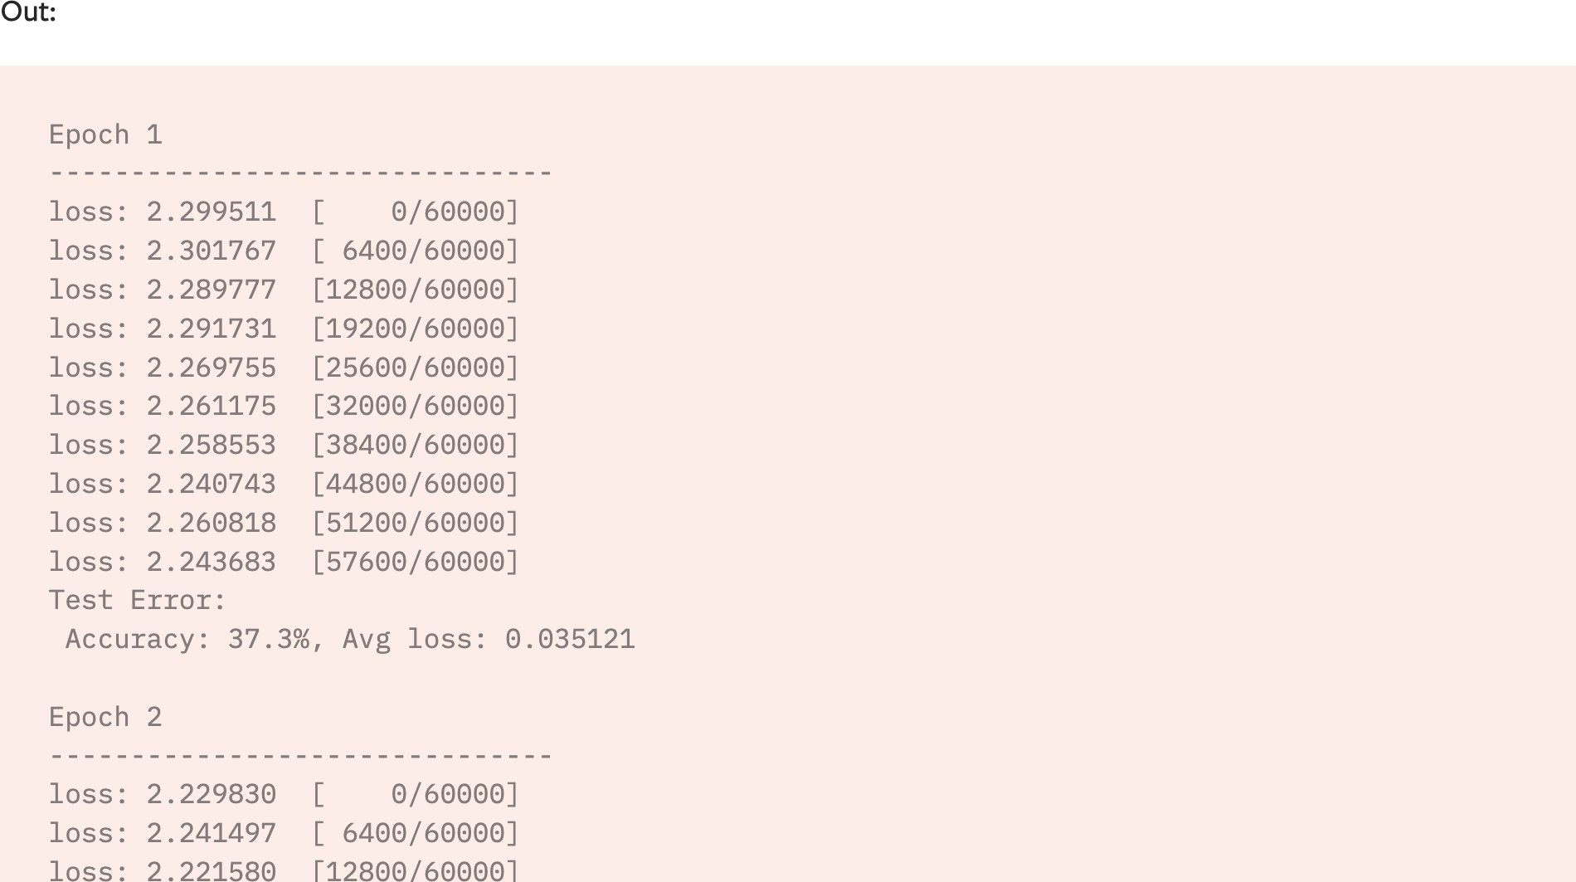
Full Implementation

Slide 35
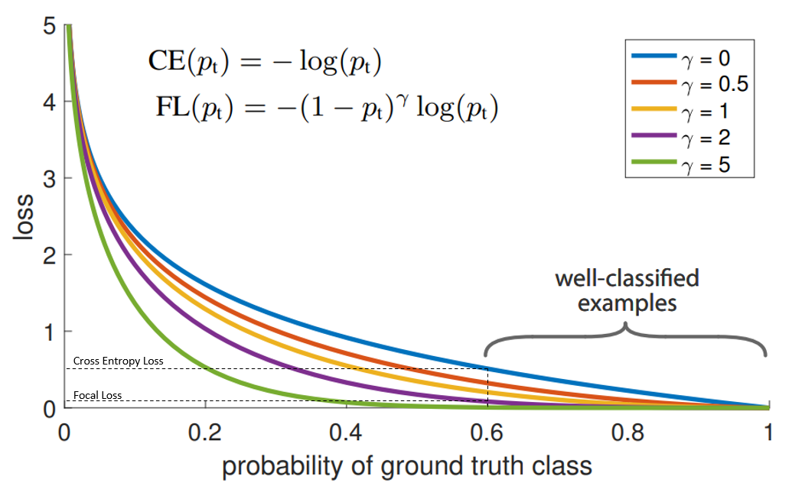
Your Own Loss - Focal Loss(BCE)

Slide 36
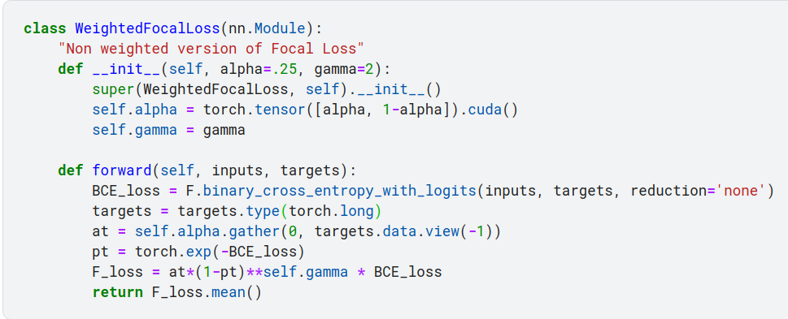
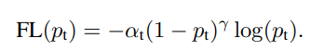
Your Own Loss

Slide 37
Save and Load the Model

Slide 38
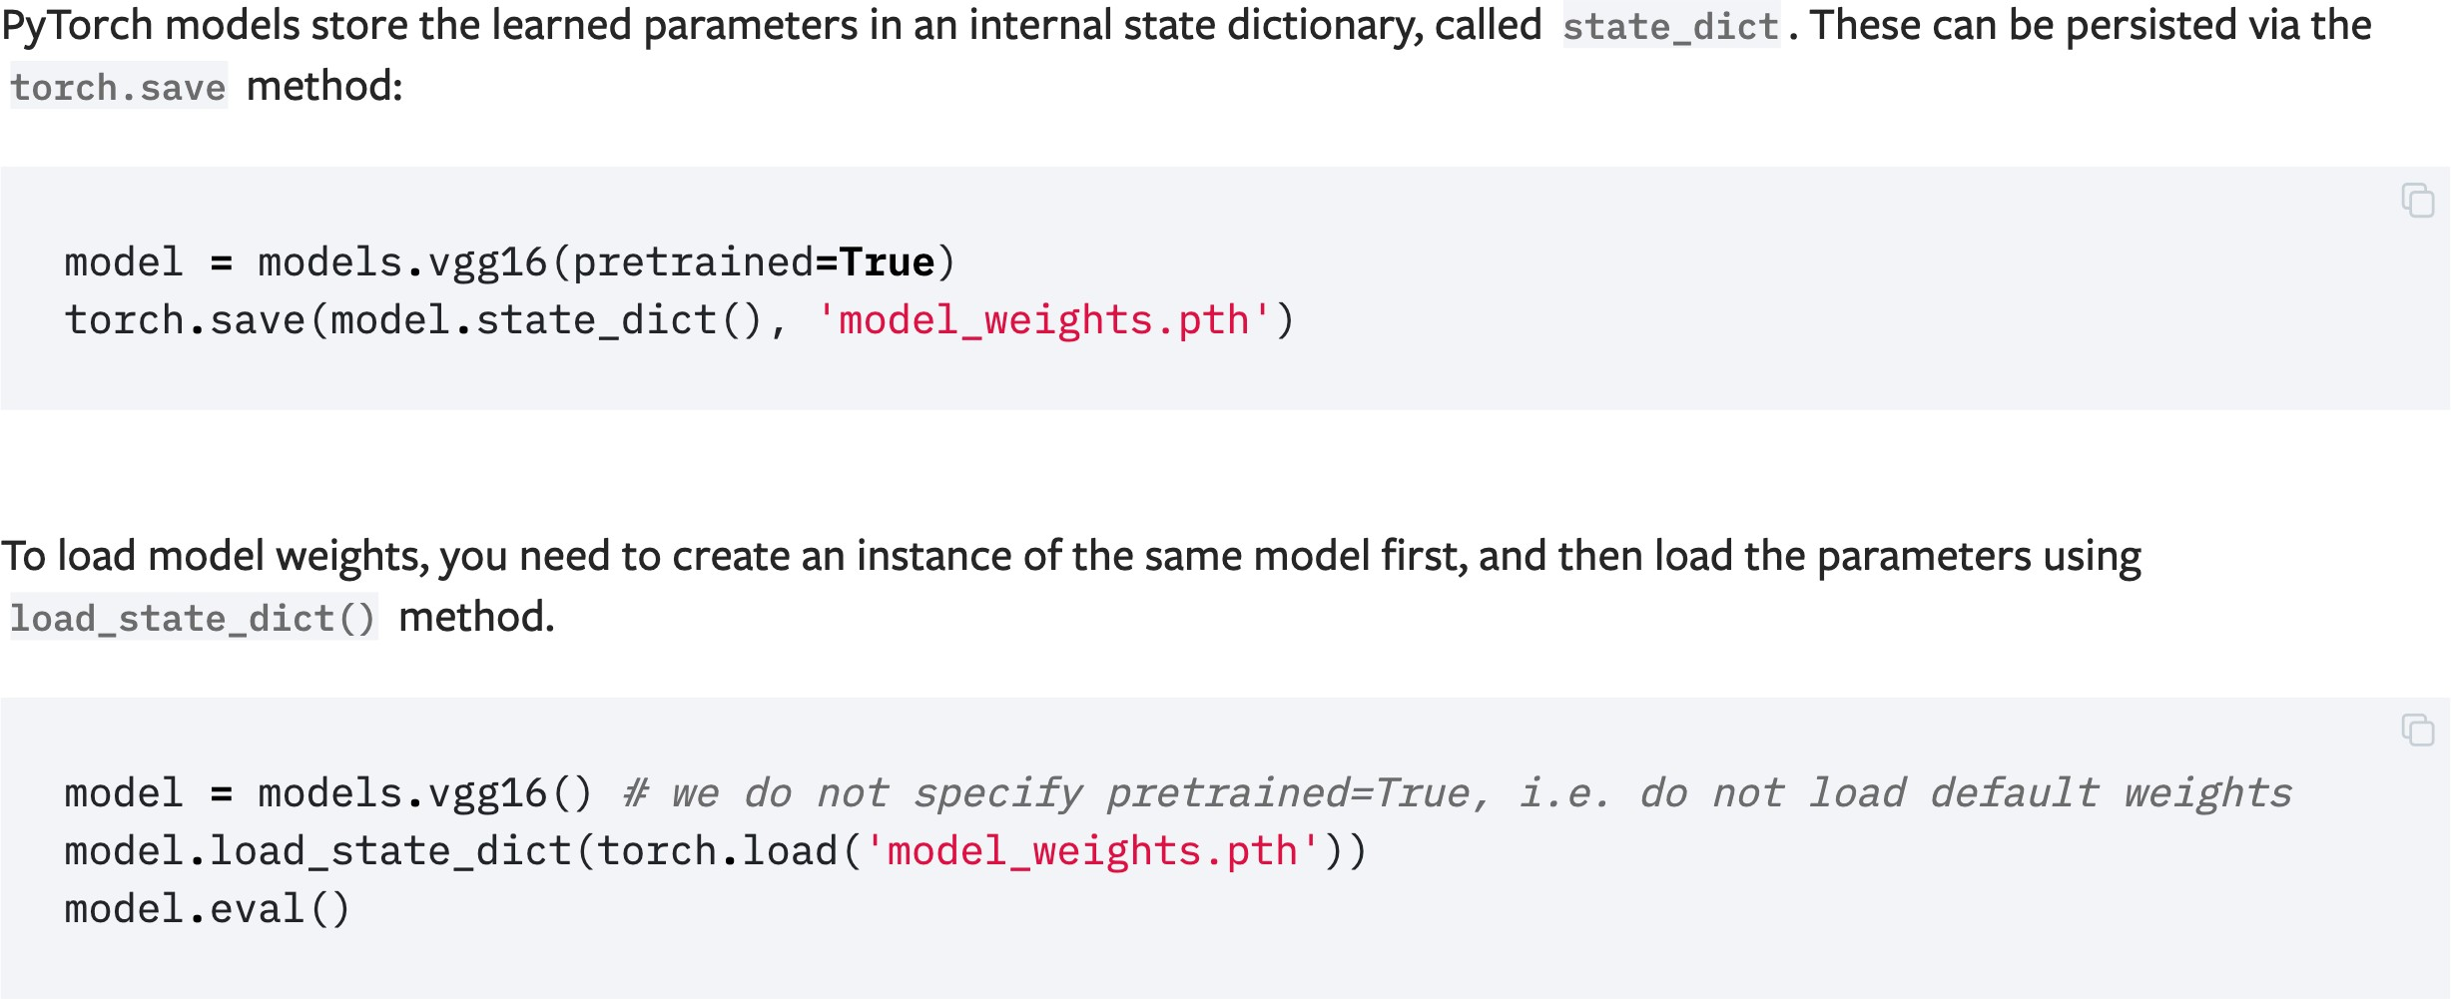
Saving and Loading Model Weights
Notes:
H5

Slide 39
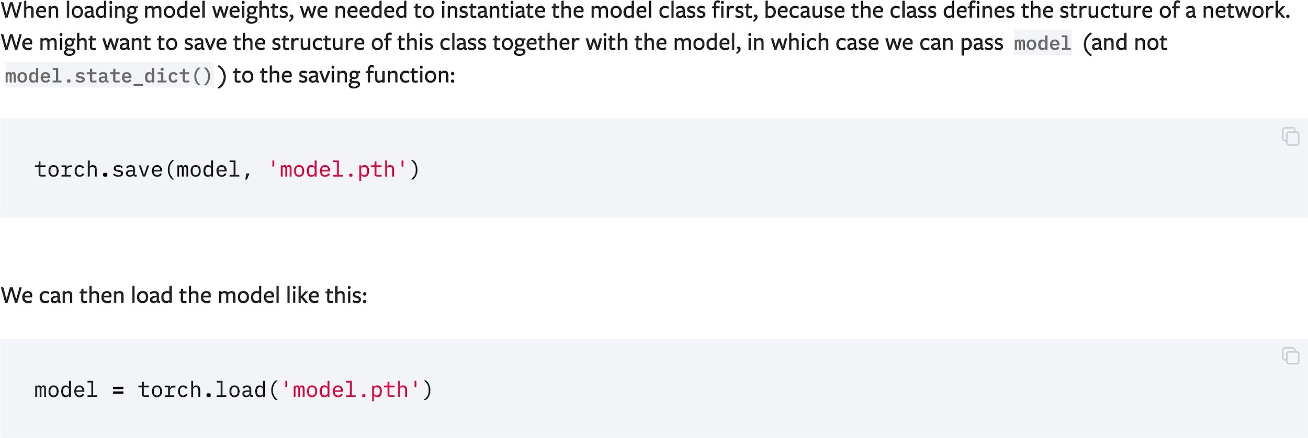
Saving and Loading Models with Shapes

Slide 40
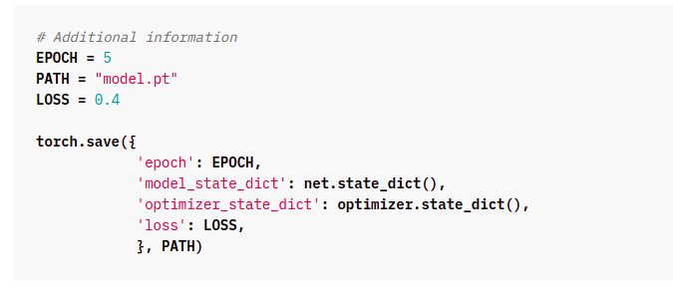
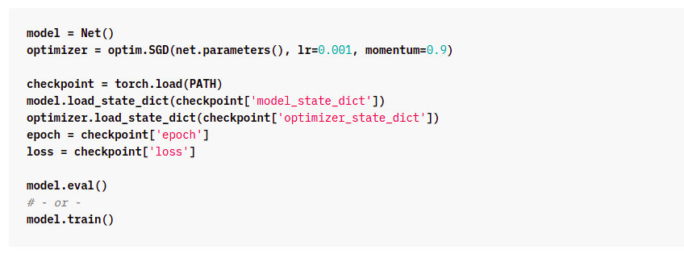
Saving and Loading a General Checkpoint
Saving
Loading

Slide 41
Acknowledgment
PyTorch Official Tutorial: https://pytorch.org/tutorials/beginner/basics/intro.html
Feel free to check out the tutorial for more details!
Notes:
spotlights

